Slide 1
Compage UI Framework
Hackathon 2016
Jugaad Team

Slide 2
Unique UI framework of PwC
Customized UI framework for versatile apps.
Better than existing frameworks in supporting more number of devices.
Reusable across projects by changing branding.
Enhanced components which are not available in existing frameworks.

Slide 3
Seamless UX across many devices
Can have a good user experience among 47+ devices
These features can be applied to Apple watch, Samsung watch, Amazon Kindle displays, Projector screen sizes all laptop, tablet and other kiosk devices.
Which is absent in Twitter Bootstrap and Foundation or any other framework.

Slide 4
More UI Components
Compage can have additional UI components which are used more commonly by our developers across any team any web project, which are absent in other frameworks.
For eg:- tagged input boxes, ajax search with images and more.

Slide 5
Easy integration of plugins
Plugins are already customized with PwC standards.

Slide 6
Built up on OOCSS
We are using OOCSS for this framework, which is used by Facebook for heavy pages and applications.
Which reduces the heaviness of the code by 40 to 60% which in turn increases the performance.

Slide 7
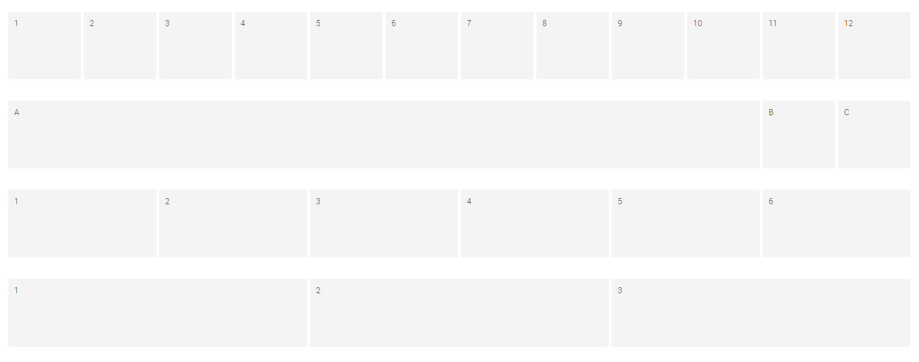
Enhanced Grid system
Grid system will be more than 20+, while for other frameworks this is 12 to 14.

Slide 8
Use of Semantic HTML tags
Using new, custom owned semantic HTML tags in the framework like <pwc>, <menubar>, <box> so that code can be easily understandable by a non-coder.

Slide 9
Reduced bugs
Overall, it can reduce a huge amount of UI bugs raised during the building phase.

Slide 10
Q&A

